Slide 1
AINT351: Machine Learning Lecture 3 P1.1 laboratory assignment

Slide 2
Assessments
There will be practical assessments in the form of Matlab coursework (70%)
First practical needs to be submitted by 12pm, 17th October 2016
Feedback within 20 days
Complete lab journal submitted 4pm, 12th January 2017

Slide 3

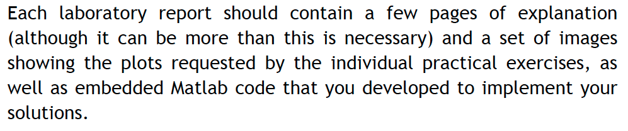
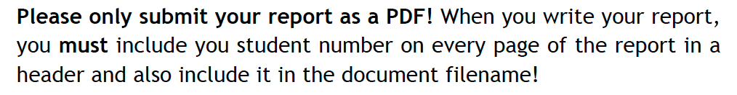
Reports
See document AINT351 Coursework Spec.pdf
Please look at the template:
AINT 351 Report Template.docx

Slide 4
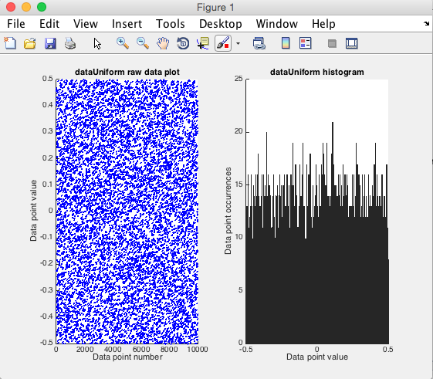
Use the rand function to generate a 1xn dimensional matrix of samples. Select a suitable number of samples Display the size of the array Plot the data against sample number using the plot command. Use the hist command and plot a histogram of the distribution Make sure your results are similar to those shown below: What can you say about the results? How many samples and bin should do you need to get sensible results.
Generate a uniform probability distribution

Slide 5
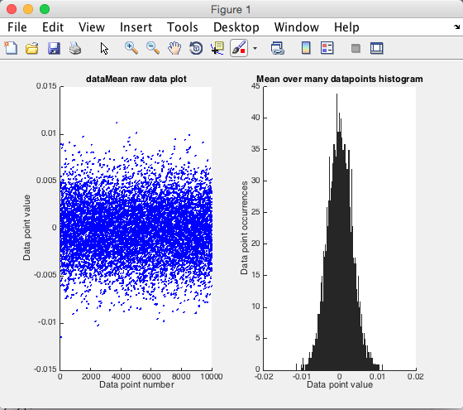
Use the rand function to generate an nxn dimensional matrix of samples. Select a suitable number of samples Display the size of the array. Plot the data dimension against sample number. Average across the 2nd dimension using the Matlab mean function Use the hist command and plot a the distribution What can you say about this distribution? How many samples and bin do you need to get “sensible” results
The central limit theorem

Slide 6
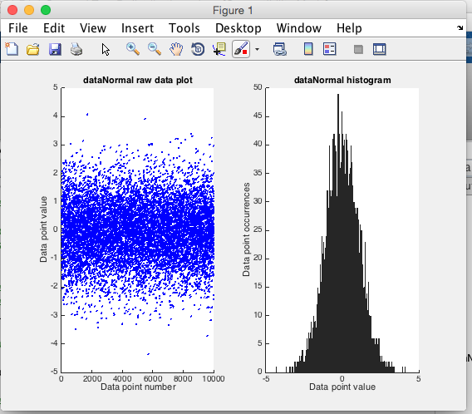
Use the randn function to generate a 1xn dimensional matrix of samples. Select a suitable number of samples Display the size of the array. Plot the data dimension against sample number. Use the hist command and plot a the distribution
Generate a normal probability distribution

Slide 7
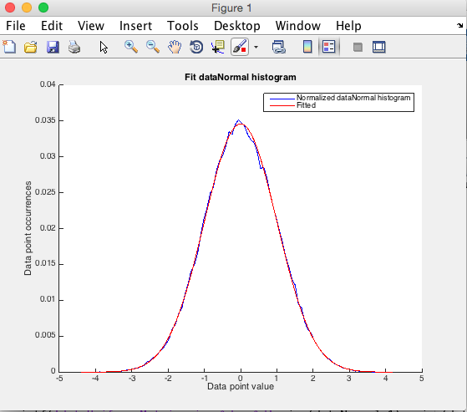
Use the randn function to generate a 1xn dimensional matrix of samples. Select a suitable number of samples Display the size of the array. Estimate the mean and variance of the data Plot the estimated Gaussian distribution onto a histogram Note you will need to scale the data appropriately and use the same sampling points
Estimate normal distribution parameters

Slide 8
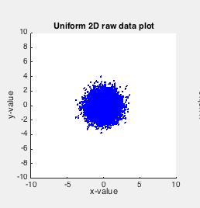
Use the randn function to generate a 2xn dimensional matrix of normally distributed samples with a standard deviation of 1 and mean of zero Select a suitable number of samples Display the size of the array. Plot the data dimension against each other to get a 2D scatter plot. What can you say about this distribution?
Generate a default 2D distribution

Slide 9
AINT351: Machine Learning Lecture 3 1D linear regression continued

Slide 10
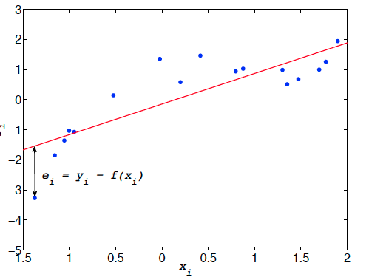
Least squares fitting
We want to fit a straight line to data measurements
Equation for a straight line in single dimension is:
Sum over all points to give overall sum of squared errors e
We now need to find m and c than minimize error e

Slide 11
Least squares fitting gradient term m
Re-writing the error term
where
We can differentiate the error with respect to m to give the gradient
where
Now
and

Slide 12
Least squares fitting offset term c
Re-writing the error term
where
We can differentiate the error with respect to c to give the gradient
where
Now
and

Slide 13
Analytical solutions
To find the gradient m and the constant term c we need to set the expressions for the gradient to zero:

Slide 14
Analytical solutions
To find the gradient m and the constant term c we need to set the expressions for the gradient to zero:
Substituting

Slide 15
Analytical solutions

Slide 16
AINT351: Machine Learning Lecture 3 Matlab matrices

Slide 17
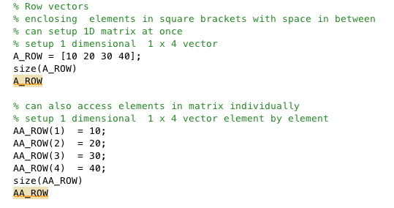
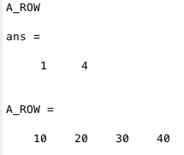
Matrices in Matlab

Slide 18
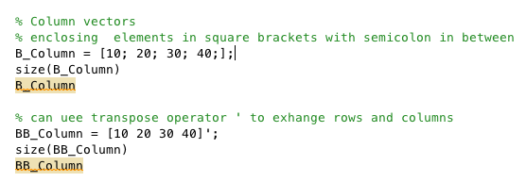
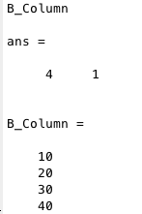
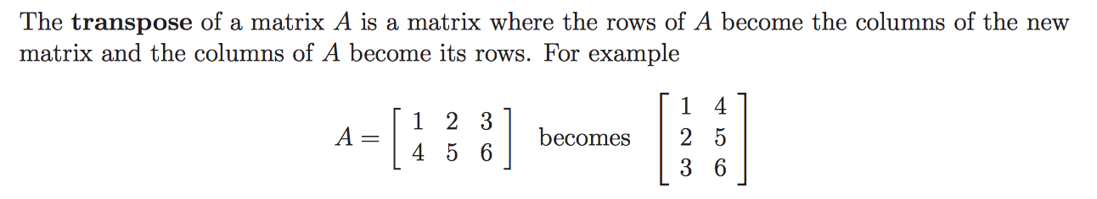
Matrices in Matlab

Slide 19

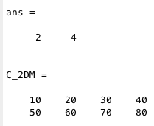
Matrices in Matlab

Slide 20
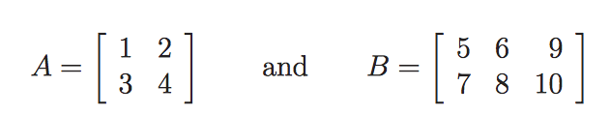
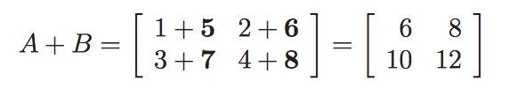
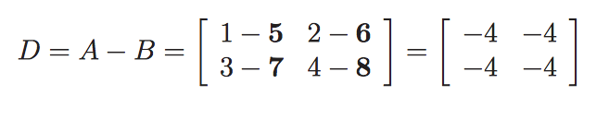
Adding matrices
Add the elements
Subtract the elements

Slide 21
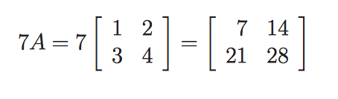
Multiplication of a matrix by a number

Slide 22
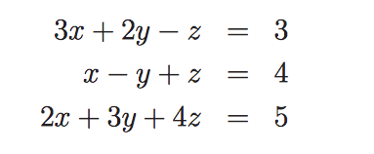

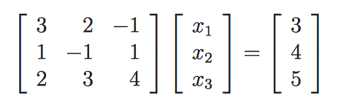
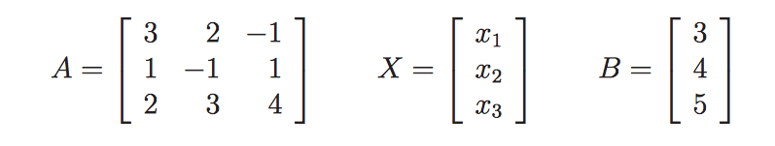
Using matrices to represent equations
Can write equations as
Where

Slide 23
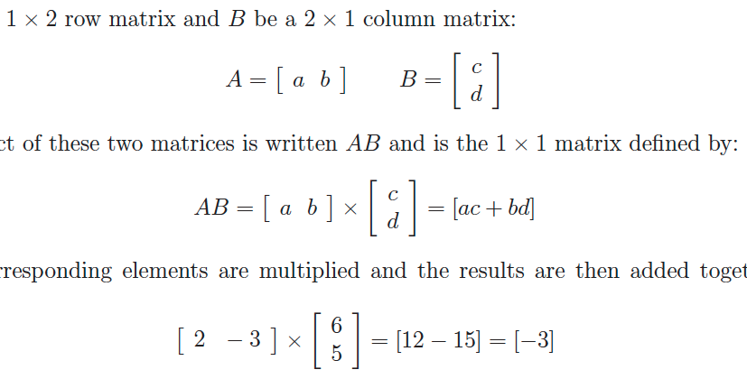
Multiplying row and column matrices
Multiply rows by columns

Slide 24
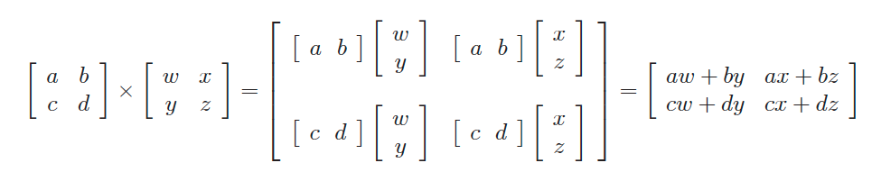
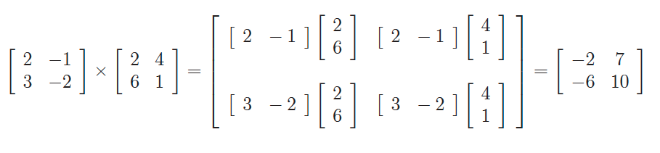
Multiplying 2x2 matrices

Slide 25
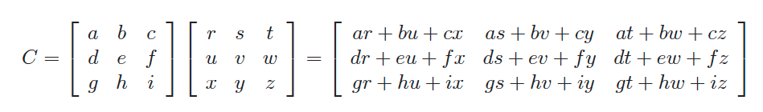
Multiplying 3x3 matrices

Slide 26

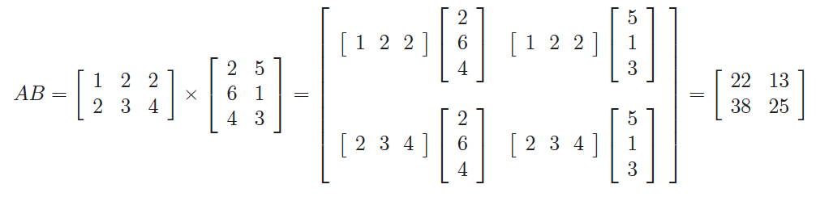
Multiplying non-square matrices

Slide 27
Inverse of a 2x2 matrix
For a 2x2 matrix
Its determinant:
Inverse:

Slide 28
AINT351: Machine Learning Lecture 3 Multidimensional linear regression

Slide 29
Multidimensional least squares fitting
A general linear model that fits multidimensional data can be written
Which can be implemented as the scalar product of vector X and weight vector W and the constant term W₀
We can re-write this expression as follows
Where X is augmented to include 1 so constant term absorbed in the new weight vector
From now on we drop the tildas and use X and W

Slide 30
We define error vector e as the difference between the measured y-values Y and the predicted-values XW
Multidimensional least squares fitting
Where W is the weight vector
We define a sum of squares SSE cost function as the scalar product of the transposed error vector with itself

Slide 31
Multidimensional least squares fitting
Given
Since
We can write
Multiplying out gives
The middle two terms are both scalars and equal

Slide 32
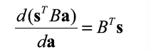
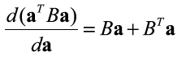
Multidimensional least squares fitting
To find a closed solution that specified the minimum SSE we need to find when the differential of the error w.r.t the weights goes to zero
Given
Now
Since it has no terms in W

Slide 33
Multidimensional least squares fitting
Thus
When the gradient is zero we have
Multiplying each side by the inverse matrix term in from of the weight vector W
Predicted values Y hat can now be computed from X hat data points using the relation

Slide 34
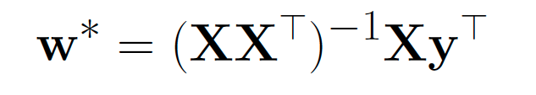

Matlab regression calculation
NB: The transpose operation is dependent on how your data is organized

Slide 35
Suggested reading
http://www.mathworks.co.uk/help/pdf_doc/matlab/getstart.pdf
J.M. Maciejowski, Getting started with MATLAB.
Christopher M. Bishop: Pattern Recognition and Machine Learning, Springer (2006)
D.J.C. MacKay: Information Theory, Inference and Learning Algorithms, Cambridge University Press

